Slide 1
CYBER SECURITY
AND IOT
PRESENTED BY,
(622421104003)
k. ASHWINTH (CSE -III)
SALEM COLLEGE OF
ENGINEERING AND TECHNIOLOGY.

Slide 2
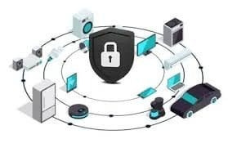
Introduction
The Internet of Things (IoT) has transformed technology interaction, presenting substantial cybersecurity challenges. This overview delves into methods for securing IoT devices and countering dynamic cyber threats.

Slide 3

PROBLEM STATEMENT
IoT devices' interconnected nature and inadequate security measures make them vulnerable to cyber attacks. Unauthorized access, data breaches, and malware infections are common consequences of these vulnerabilities.

Slide 4

PROPOSED SYSTEM/SOLUTION
Implementing robust encryption protocols is crucial in securing
IoT devices. End-to-end encryption and strong authentication mechanisms help prevent unauthorized access and ensure data integrity.

Slide 5

System Development Approach
Adopt a secure system development life cycle (SDLC) approach.
Incorporate security requirements from the initial design phase.
Perform thorough security testing and vulnerability assessments.
Implement secure update mechanisms for continuous security improvements.

Slide 6

Algorihtm and Deployment
Access control mechanisms such as role-based authorization and multi-factor authentication are crucial for restricting unauthorized access to IoT devices and sensitive data during algorithm deployment.

Slide 7

Result
Regular monitoring of IoT devices and timely security updates are essential to detect and mitigate potential vulnerabilities, protecting devices from evolving cyber threats.

Slide 8

FUTURE SCOPE
Future scope in cybersecurity for IoT involves leveraging AI and machine learning for proactive threat detection and enhancing collaboration among stakeholders to address ongoing security challenges.

Slide 9


REFERENCE
Studying actual cases of successful IoT security implementation in organizations can oﬀer valuable insights and inspiration for enhancing cybersecurity measures eﬀectively.

Slide 10

CONCLUSION
IoT oﬀers immense potential, yet introduces cybersecurity risks. Securing IoT requires collaborative eﬀorts across stakeholders.Prioritizing security by design, best practices, and robust measures is key. Addressing cybersecurity
enables safe IoT growth while maintaining trust

Slide 11
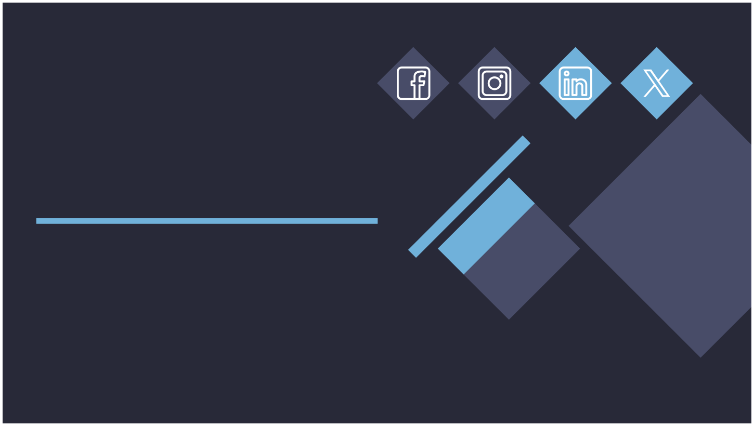
Thank YOU!

